Slide 1
You can run SQL Server on AWS? John McCormack | DATA:Scotland | Sep 2019

Slide 2
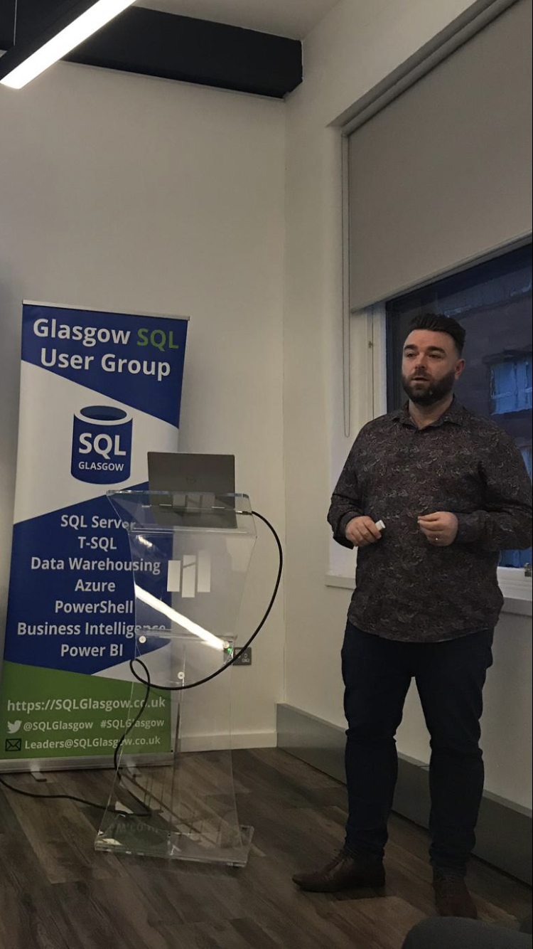
Hello!
John McCormack
DBA since 2012
https://johnmccormack.it
@actualjohn
https://linkedin.com/in/johnmccormackdba/

Slide 3












Slide 4


Slide 5
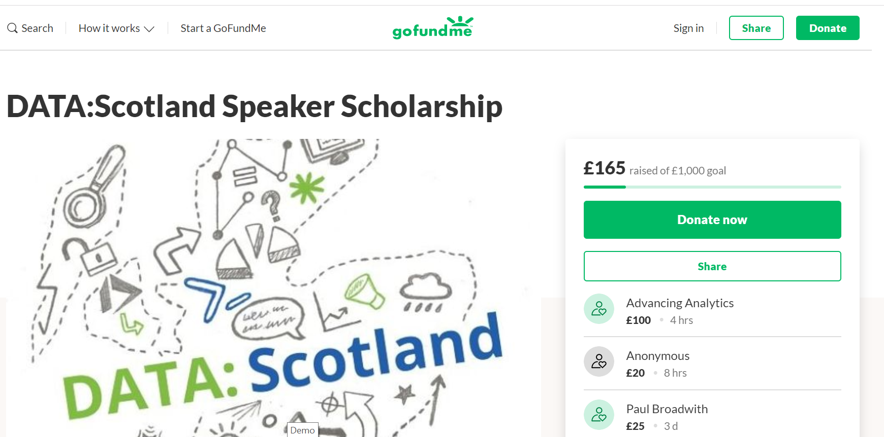
https://bit.ly/ds-speaker

Slide 6
Terminology
AWS – Amazon Web Services (Cloud computing company)
Region – A geographic area comprising of 2 or more AZs
Availability Zone (AZ) – A data centre within a region, providing options for HA/DR
EC2 – VM within AWS (Windows or Linux)
EBS – Block storage in AWS
S3 – Object storage based in AWS (think dropbox)
Bucket – Folder within S3. Name is globally unique
RDS – Relational Database Service. e.g. SQL Server, MySQL, Postgressql, Oracle, MariaDB and Aurora

Slide 7
2 ways to run SQL Server in AWS
RDS
Managed instance
Less admin, less control
EC2
VM in the cloud
More admin, more control
EC2
Azure VM
Control
RDS
Azure MI
Azure SQL DB
Administration Effort

Slide 8
RDS vs EC2
FEATURE | EC2 | RDS
Use SSMS | ✔ | ✔
Use database as source or target for SSIS | ✔ | ✔
Full control over the instance | ✔
Automated Backups |  | ✔
Automated Patching |  | ✔
Always On Availability Groups | ✔ | (Kind of)

Slide 9
RDS vs EC2 (continued)
FEATURE | EC2 | RDS
AWS Managed Multi-AZ |  | ✔
Log Shipping | ✔
Replication | ✔
Database Mail | ✔
Bulk Insert | ✔
FILESTREAM | ✔

Slide 10
Shared responsibility model
AWS | EC2 | RDS
HA/DR | YOU 👉 | AWS
Database Backups | YOU 👉 | AWS
SQL Server Patching | YOU 👉 | AWS
Installing SQL Server | YOU 👉 | AWS
OS Patching | YOU 👉 | AWS
Network | AWS | AWS
Power | AWS | AWS
Physical Security | AWS | AWS

Slide 11
Lets talk licensing
RDS
Express edition is the only license free edition
License included in instance cost
- Standard, Enterprise, Web
EC2
You can use developer edition for non prod workloads
BYOL or License included
No software assurance = Dedicated host

Slide 12
Backup / Restore - RDS
Automated backups
– Set your own retention period
Take ad-hoc snapshots
– Kept in your S3 bucket until deleted by user
Snapshots can be shared between accounts (prod to dev)
– Accounts is similar to subscriptions in Azure
Point in time restores (within 5 minutes)
You can restore to a new RDS instance

Slide 13
Backup / Restore – EC2
Responsible for your own backups and restores
Just like on-premises
Backup directly to file system
EBS offers automatic redundancy and encryption
Back up to S3 to save money
Directly with 3rd party tools
Copy from EBS to S3
S3 offers cross-region bucket replication and versioning !
You pay for all versions so look at setting a ‘lifecycle policy’

Slide 14
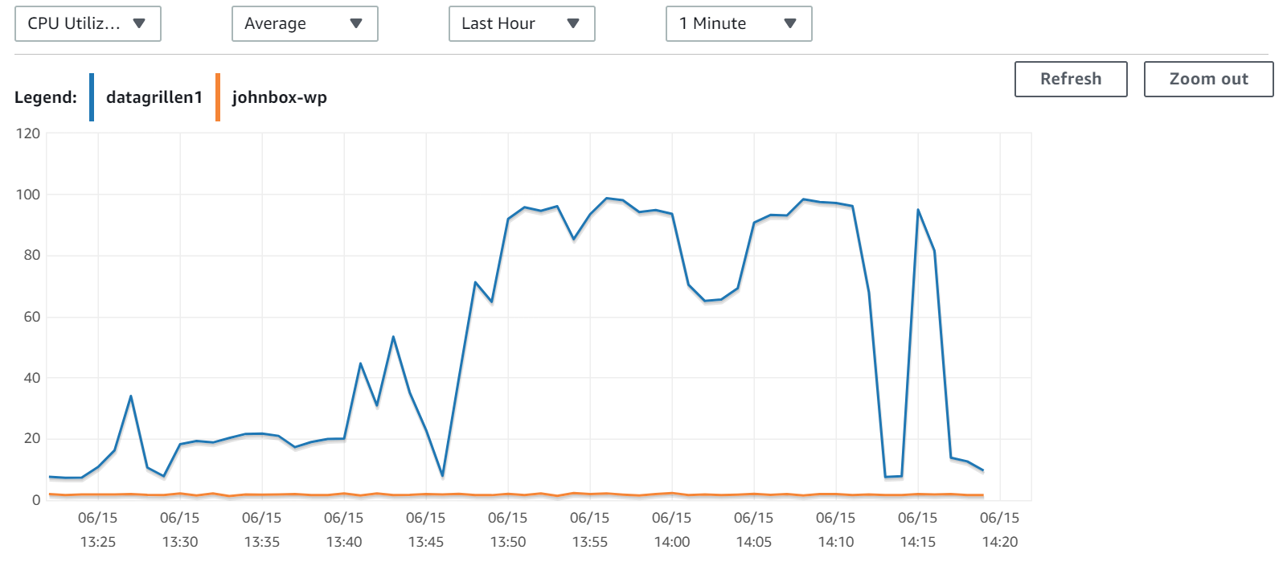
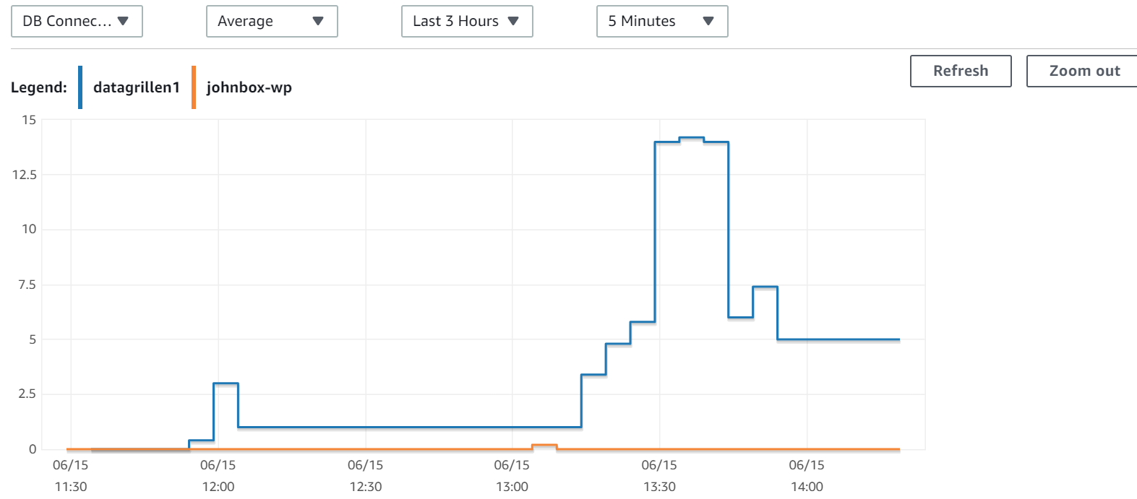
Monitoring
CloudWatch
Near real time info
View multiple instances at once
Trigger alerts
3rd party tools
sp_whoisactive
Sentry One
Grafana

Slide 15
Deep dive into RDS
Versions and Editions
Instance types
Storage types
HA/DR
Security
Encryption
Parameter groups

Slide 16
RDS – Versions & Editions
Express
Web
Standard
Enterprise
2012 – 2017
SQL Server 2008 R2 was removed from options on 1st June 2019.
Customers who didn’t act were automatically upgraded 🤦‍♂️

Slide 17
RDS – Instance Types
T2
Lowest Cost
Burstable Performance
t2.micro = 1vCPU | 1 GiB RAM
M4/M5
General Purpose
M5 is latest Generation
m5.xlarge = 4vCPU | 16 GiB RAM
R4/R5
Memory optimized
R4 latest generation
r4.xlarge = 4vCPU | 32 GiB RAM
$200 more but no increased licensing $$

Slide 18
RDS – Storage
All EDITIONS
Magnetic * | Min: 200 GiB Enterprise/Standard editions, 20 GiB Web/Express Max: 1 TiB all editions
General Purpose (SSD) | Min: 200 GiB Enterprise/Standard editions, 20 GiB Web/Express Max: 16 TiB all editions
Provisioned IOPS (SSD) | Min: 200 GiB Enterprise/Standard editions, 100 GiB Web/Express Max: 16 TiB all editions

Slide 19
RDS – Multi AZ
Automatic Multi-AZ deployment
Manual failovers
Any fault with original primary is fixed for you
Mirroring or Always On Availability Groups
Just tell AWS you want to go Multi-AZ
Automatically chosen depending on version / edition
No readable secondary with AGs
No manual intervention needed to fix original primary in case of failover
Pick a time to test that suits your business

Slide 20
RDS – Security
Network Security
VPC
Security Groups
Choose your port
Database security
SQL Logins
Master user & others
Active Directory

Slide 21
RDS – Parameter Groups
Parameter groups allow you to change settings above and beyond your level of access to the instance.
i.e Something requiring sysadmin or securityadmin role
Examples
Some trace flags e.g. 1204, 1222
Cost threshold for parallelism
Optimize for ad hoc workloads
Changes to parameter groups apply to all instances using the group

Slide 22
RDS – CLI & PowerShell
Cloud computing at scale requires automation
AWS supports CLI and Powershell to save you from too many clunky manual process
Examples
aws rds restore-db-instance-from-db-snapshot
Restore-RDSDBInstanceFromDBSnapshot
We will cover scripting in detail during the demo – learn at least 1

Slide 23
DEMO

Slide 24


Thanks!
If you want to find out more
You can find me at
@actualjohn
johnmccormack.it (Slides plus bonus content)

Slide 25
Bonus Content

Slide 26



Migration Planning
Snowball / Edge
Direct Connect
S3 Accelerated Transfer
50 / 80 / 100 TB per device
Can use multiple
Transfers in 1 week
PB Scale
Dedicated connection
1Gbps – 10 Gbps
TB / GB Scale
Cloudfront Edge Locations
Distance ∝ improvement
GB / MB Scale

Slide 27
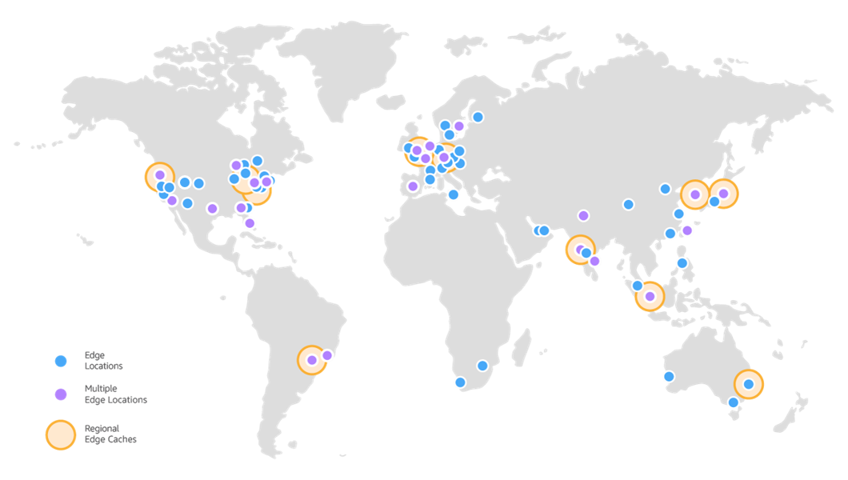
CloudFront Edge Locations
© https://aws.amazon.com/cloudfront/features/#Amazon_CloudFront_Infrastructure

Slide 28
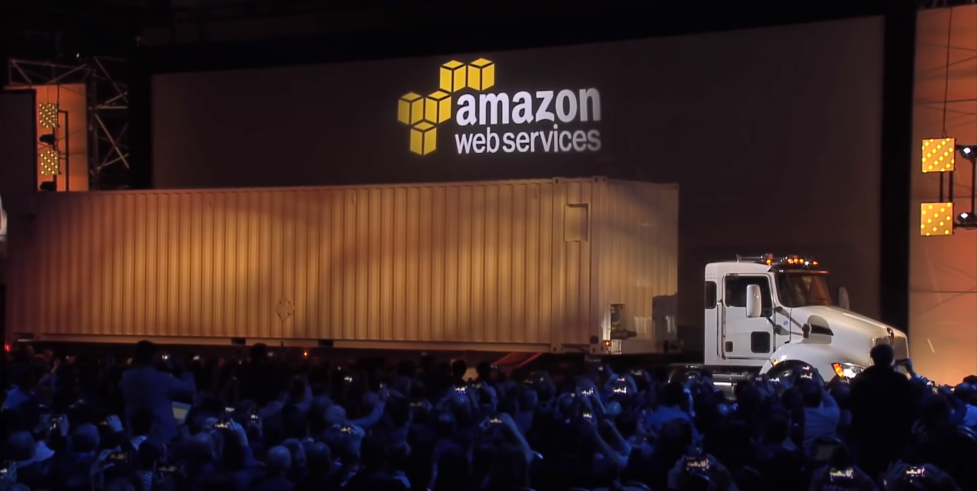
Snowmobile
Petabyte Scale

Slide 29
Pre Migration Planning
TASK
Create full inventory
Identify features used (What version / edition do we need)
Do you have licenses to take to the cloud?
What are your high availability / disaster recovery requirements
Can you purge unwanted data
What are your team’s capabilities

Slide 30
Migration strategies and tools
METHOD | EC2 | RDS
BACKUP / RESTORE | ✔ | ✔
Database Migration Service / Schema Conversion Tool | ✔ | ✔
Log Shipping | ✔
Transactional Replication | ✔
Snowball | ✔ | ✔

Slide 31
Really the end

Slide 32
Credits
Special thanks to all the people who made and released these awesome resources for free:
Presentation template by SlidesCarnival
Photographs by Unsplash

